Slide 1
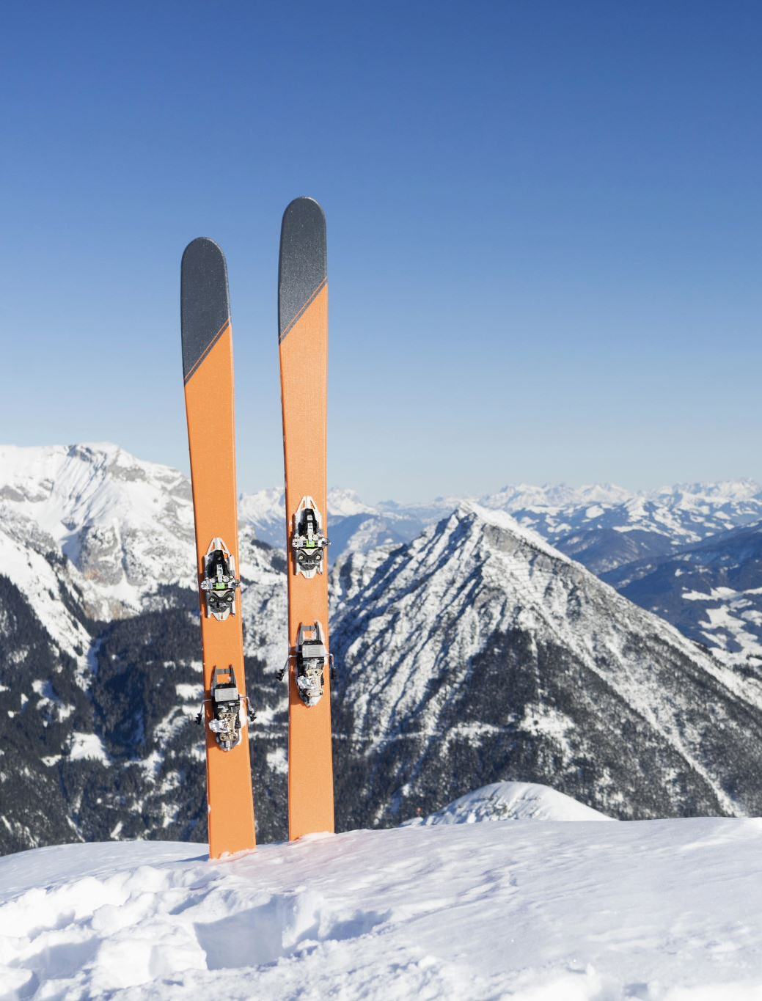
Data Science Project Presentation:
Big Mountain Ski Resort Guided Capstone
Emily Cuttle

Slide 2
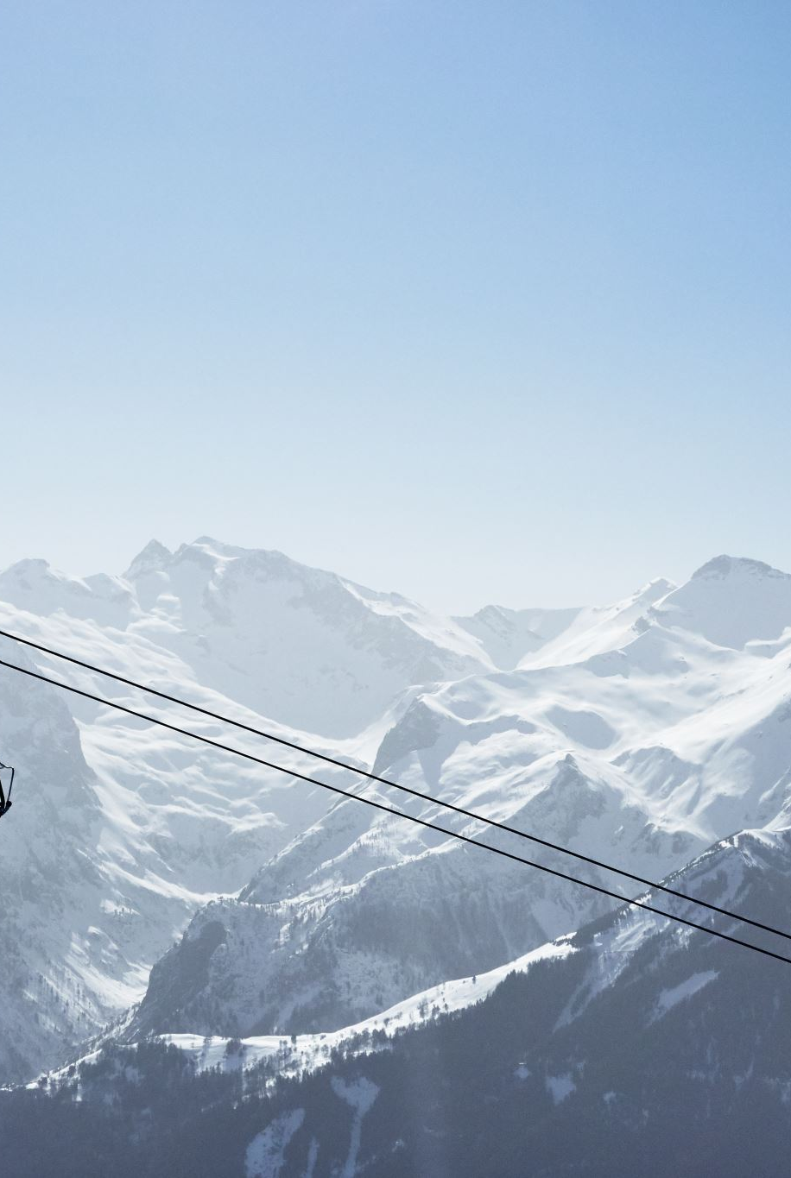
Problem Identification
How can Big Mountain Ski Resort leverage their facilities to increase ticket price to offset the additional operating costs of $1.54 million due to the installation of an additional chairlift?

Slide 3
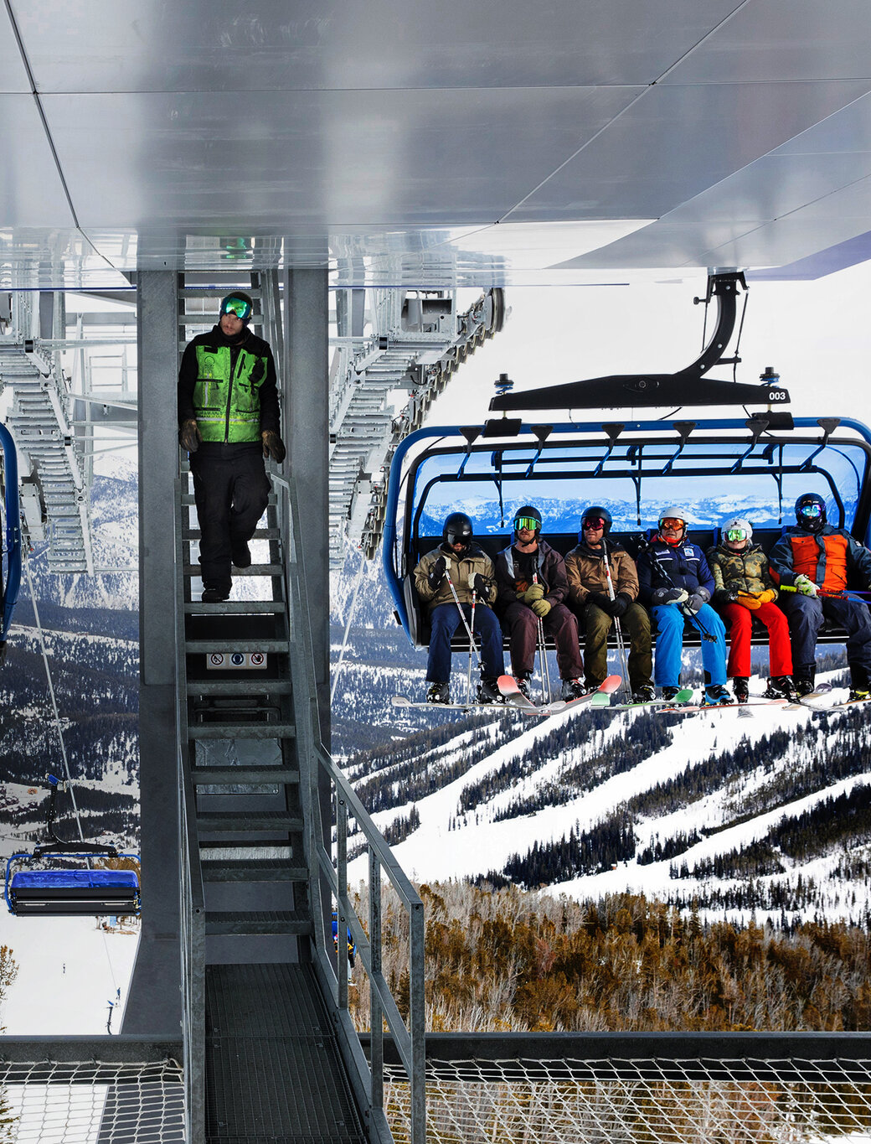
Problem Identification
Criteria for Success:
Ticket prices are raised based off of successfully selecting facilities.
This price raise offsets the additional operating cost of $1.54 million this season.
It does not lead to a decrease in business revenue.
Constraints within the Solution Space:
Increasing the ticket price could drive away business due to competition from other resorts.
Need to find the optimal ticket price that will maximize revenue while not driving away business.

Slide 4
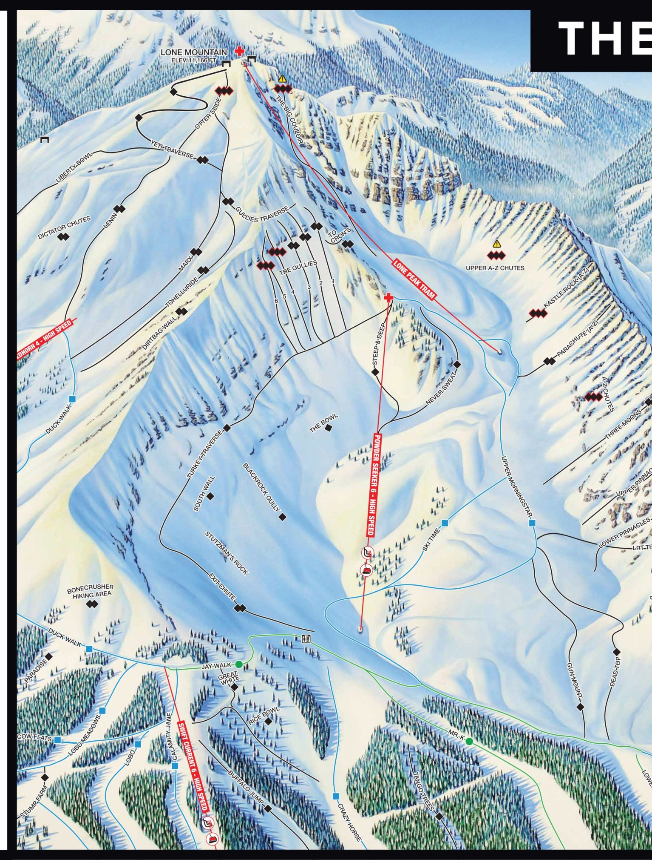
Recommendations & Key Findings
Recommendations:
Increase the current ticket price from $81 to as high as $95.87
Investment Strategy:
Option 2: adding a run, increasing the vertical drop by 150 feet, and installing an additional chair lift to increase support for ticket price by $1.99
Key Findings:
The modeled ticket price is $95.87 with a mean absolute error of $10.39
Big Mountain’s resort features rank highly on the league charts when compared to other resorts
Investment Strategies:
Option 1 – closing runs reduces support for ticket prices, and so revenue
Option 2 – increases support for ticket price by $1.99, which over the season, could be expected to amount to $3,474,638
Option 3 – shows no support for further increasing ticket price
Option 4 – has no effect on ticket price

Slide 5
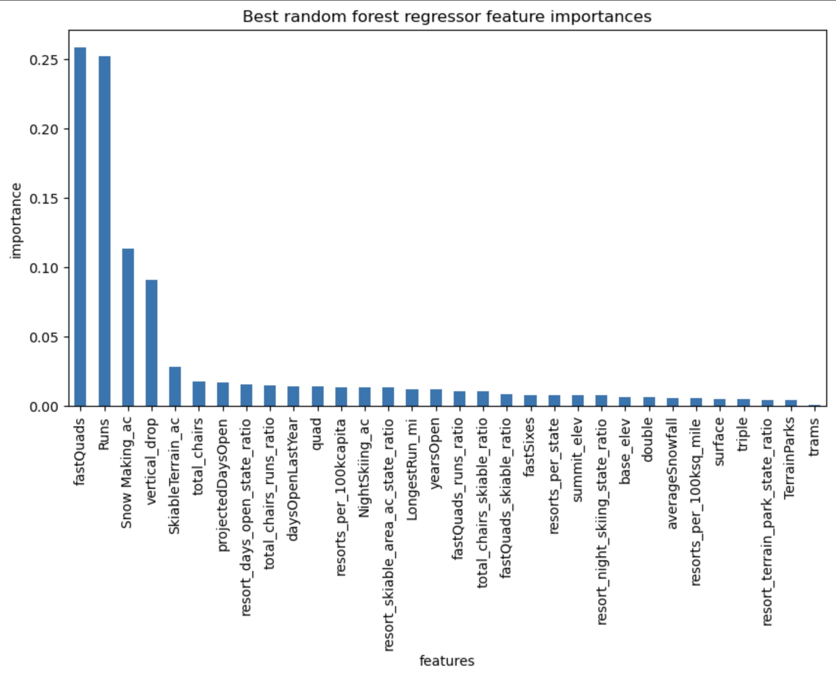
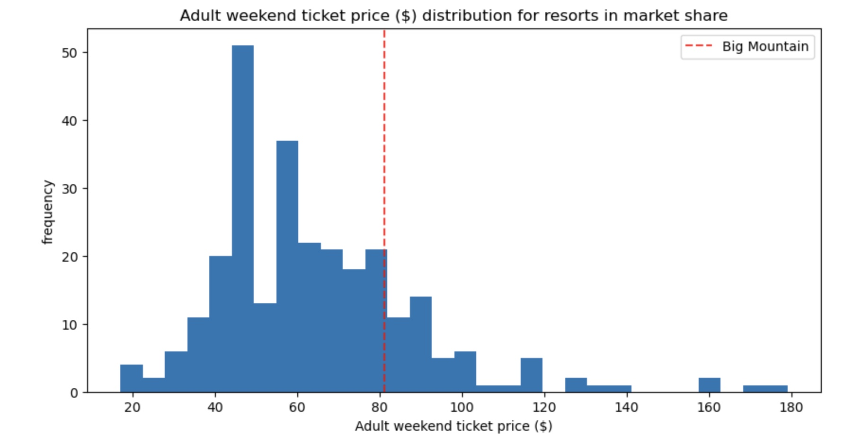
Modeling Results & Analysis

Slide 6
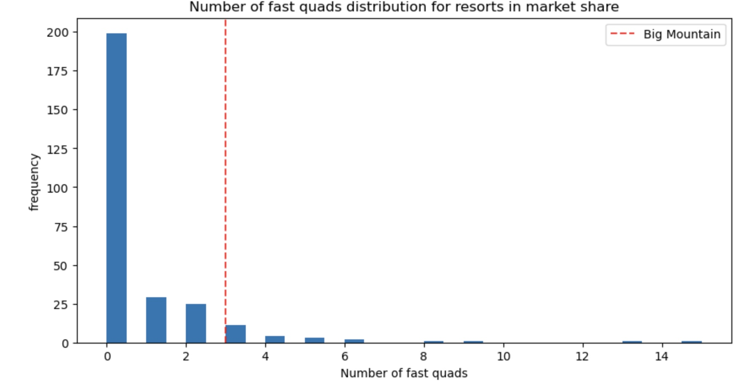
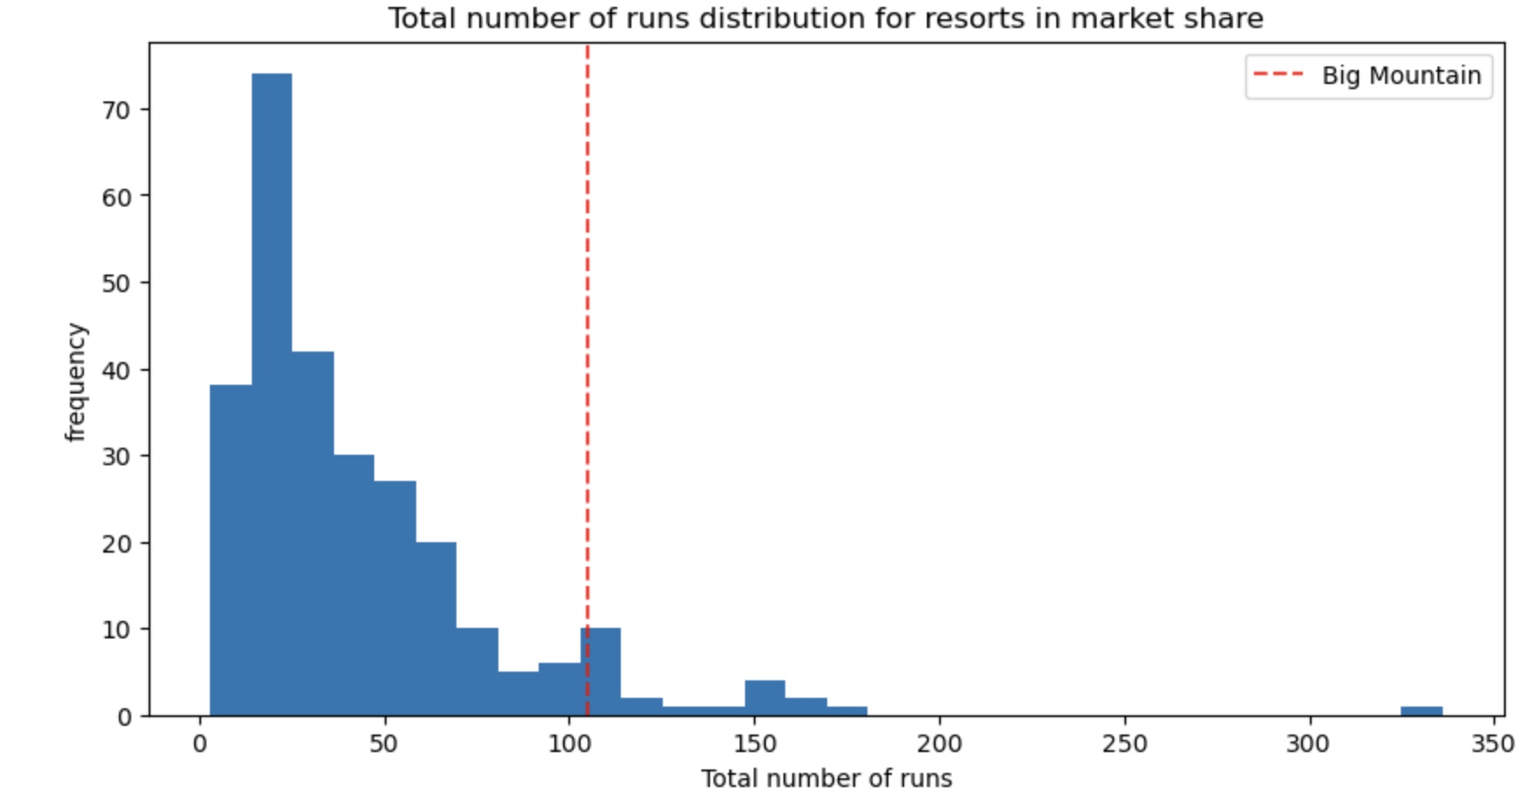
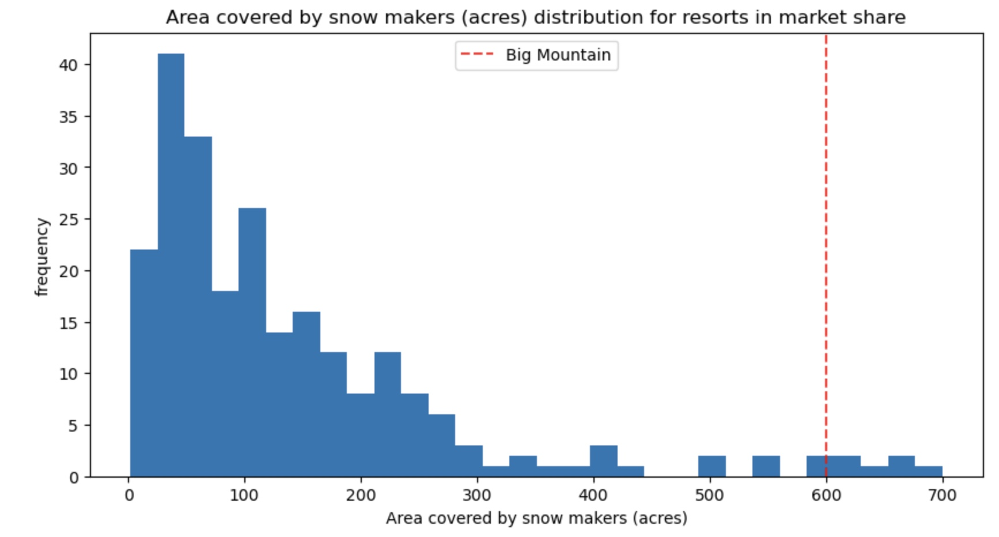
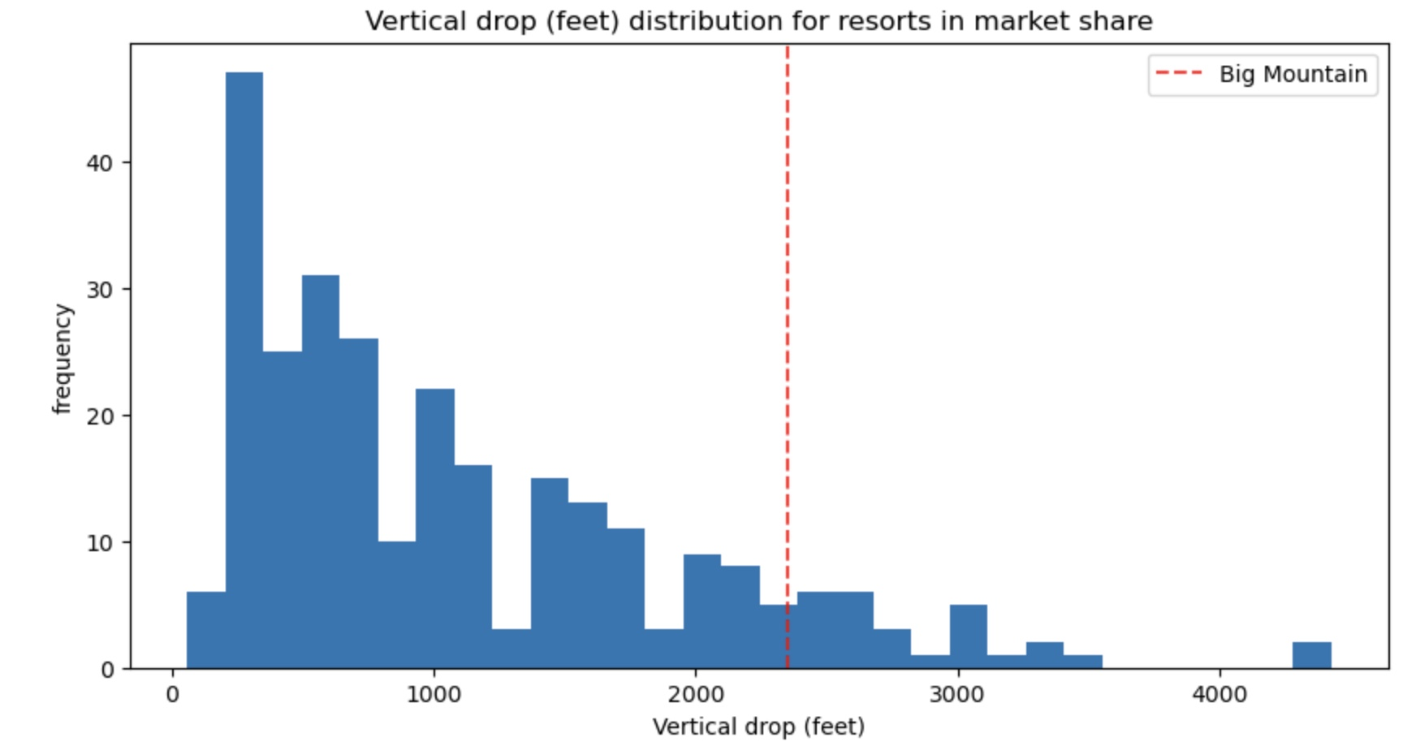
Modeling Results & Analysis

Slide 7
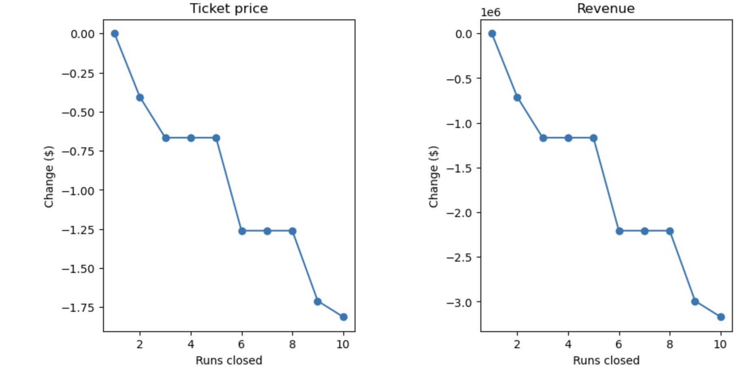
Modeling Results & Analysis
Investment Strategies: Option 1

Slide 8
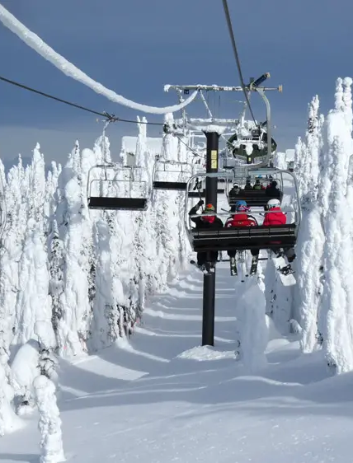
Summary & Conclusion
Big Mountain Ski Resort currently charges $81 dollars for an adult weekend ticket.
The modeled ticket price is $95.87 with a mean absolute error of $10.39, suggesting there is room for a price increase.
Big Mountain’s resort features rank highly on the league charts when compared to other resorts.
Investment Strategies:
Option 2 supports raising the ticket price by adding a run, increasing the vertical drop by 150 feet, and installing an additional chair lift.
Increases support for raising the ticket price by $1.99, which over the season, could be expected to amount to $3,474,638.

